Slide 1

المبادرة الإقليمية لتقييم أثر تغيّر المناخ على الموارد المائية وقابلية تأثر القطاعات الاجتماعية والاقتصادية في المنطقة العربية (ريكار)
سلسلة ندوات ريكار عبر الانترنت حول تحليل تغير المناخ باستخدام أدوات نظم المعلومات الجغرافية
الوحدة 1 – تقديم مجموعات بيانات ريكار الناتجة عن النمذجة المناخية الإقليمية و النمذجة الهيدرولوجية الإقليمية
Notes:
المبادرة الإقليمية لتقييم أثر تغيّر المناخ على الموارد المائية وقابلية تأثر القطاعات الاجتماعية والاقتصادية في المنطقة العربية (ريكار)
سلسلة ندوات ريكار عبر الانترنت حول تحليل تغير المناخ باستخدام أدوات نظم المعلومات الجغرافية
الوحدة 2: عرض مجموعات بيانات النمذجة المناخية الإقليمية بصيغة NetCDF في نظم المعلومات الجغرافية

Slide 2
سلسلة ندوات ريكار عبر الانترنت
الوحدة 1 – تقديم مجموعات بيانات ريكار الناتجة عن النمذجة المناخية الإقليمية و النمذجة الهيدرولوجية الإقليمية
الوحدة 2- عرض مجموعات بيانات النمذجة المناخية الإقليمية بصيغة NetCDF في نظم المعلومات الجغرافية
الوحدة 3- استخراج البيانات الجدولية من الملفات المناخية بصيغة NetCDF لاستخدامها في النماذج والتطبيقات الأخرى
الوحدة 4- إنشاء مجموعة لإسقاطات النمذجة المناخية الإقليمية باستخدام نظم المعلومات الجغرافية ومؤشرات الظواهر المناخية المتطرفة
الوحدة 5- الوصول إلى مجموعات البيانات المناخية العالمية والإقليمية والمنصات ذات الصلة
الوحدة 6- منهجية التقييم المتكامل لقابلية التأثر المتبعة في ريكار
Notes:
سلسلة ندوات ريكار عبر الانترنت
الوحدة 1 – تقديم مجموعات بيانات ريكار الناتجة عن النمذجة المناخية الإقليمية و النمذجة الهيدرولوجية الإقليمية
الوحدة 2- عرض مجموعات بيانات النمذجة المناخية الإقليمية بصيغة NetCDF في نظم المعلومات الجغرافية
الوحدة 3- استخراج البيانات الجدولية من الملفات المناخية بصيغة NetCDF لاستخدامها في النماذج والتطبيقات الأخرى
الوحدة 4- إنشاء مجموعة لإسقاطات النمذجة المناخية الإقليمية باستخدام نظم المعلومات الجغرافية ومؤشرات الظواهر المناخية المتطرفة
الوحدة 5- الوصول إلى مجموعات البيانات المناخية العالمية والإقليمية والمنصات ذات الصلة
الوحدة 6- منهجية التقييم المتكامل لقابلية التأثر المتبعة في ريكار

Slide 3



Live Event Guidance for Participants
Webinar webpage provides: PPT handouts in English and Arabic for each module, the link to live event (posted the morning of the live session) & recordings following each session.
www.unescwa.org/RICCAR-webinar-climate-change-GIS
As we have over 400 registered participants (443 specifically), we are broadcasting the webinars as live events.
You will not be able to interact using your video or audio.
Please send your name, affiliation and country in the Q&A Chat so others know that you are connected and we know that you joined.
Pose questions and offer comments using the Q&A Chat at anytime during the session.
Dr. Marlene Tomaszkiewicz – who will be delivering the next 5 webinars in this series – and Joelle Comair will be responding to your questions via the chat.
You can submit your questions in English, Arabic or French.
Arabc Webinar will be delivering by ACSAD:Eng.Hiam AlAshkar , Eng.Ghazwan Naser.
I will respond to lingering inquiries the end of the presentation noting that we will respect the one hour mark for this recorded session.
We are then happy to follow-up with you by email following the sessions.
So let’s get to it!
Notes:
Dr. Marlene Tom-a-SKEV-itch

Slide 4
الوحدة الأولى: المحتويات
تفويض ريكار والنطاق العربي/منطقة الشرق الأوسط وشمال أفريقيا.
فهم سيناريوهات المناخ ومسارات التركيز النموذجية المتبعة في التقرير الخامس للهيئة الحكومية الدولية المعنية بتغير المناخ.
إقليمية أو عالمية : مزايا إسقاطات ومجموعات بيانات النمذجة المناخية الإقليمية والنمذجة الهيدرولوجية الإقليمية .
بارامترات المناخ والمؤشرات المناخية للنماذج المتعلقة بالأرض.
النتائج الرئيسية للنمذجة المناخية الإقليمية والنمذجة الهيدولوجية الإقليمية في ريكار.
التقييم المتكامل لقابلية التأثر.
المركز الإقليمي للمعرفة.
Notes:
* This module on RICCAR regional climate modelling and hydrological modelling datasets: An introduction
* It will provide some of the Fundamentals needed to pursue climate change analysis at the regional level – and specifically in the Arab region.
* A few slides have been added to the end to introduce you to how the RICCAR’s Regional Climate Modeling and Hydrological Modeling projections were used to inform our integrated VA, which will be delved into more deeply in the final Sixth Session in this webinar series.
* The presentation will also briefly introduce you to the RKH, which can provide you with more resources to help you to draw upon the RICCAR findings, methods and pursue your own climate change analysis.

Slide 5
ﺍﻟﺗﻔﻭﻳﺿﺎﺕ ﺍﻟﺩﻭﻟﻳﺔ ﺍﻟﻣﻌﻧﻳﺔ ﺑﺩﻋﻡ ﺍﻟﺗﻘﻳﻳﻣﺎﺕ ﺣﻭﻝ ﺗﻐﻳﺭ ﺍﻟﻣﻧﺎﺥ ﻓﻲ ﺍﻟﻣﻧﻁﻘﺔ ﺍﻟﻌﺭﺑﻳﺔ
Arab Ministerial
Declaration on
Climate Change
CAMRE
2007
Arab
Economic and Social Summit Resolution on IWRM Water & Climate Change Project
2009
Arab Permanent Committee for Meteorology
Resolutions
2012, 2013, 2014, 2015, 2016, 2017, 2018, 2019
ESCWA
30th Ministerial Session
Resolution sets up Arab Centre for Climate Change Policies
2018
ESCWA
25th Ministerial Session Resolutions on Climate Change, Rio+20 follow-up
2008, 2012, 2014
Arab Ministerial Water Council Resolutions
2010, 2011, 2012, 2013, 2014, 2015, 2016, 2017, 2108, 2019
ACSAD Board of Directors
Resolution
2013, 2018
Environment
Foreign Affairs & Planning
Water
Met
Agriculture

Slide 6
ﻫﺪﻑ ﻣﺒﺎﺩﺭﺓ ﺭﻳﻜﺎﺭ
  لتقييم ﺗﺄﺛﻳﺭ ﺗﻐﻳﺭ ﺍﻟﻣﻧﺎﺥ ﻋﻠﻰ ﻣﻭﺍﺭﺩ ﺍﻟﻣﻳﺎﻩ ﺍﻟﻌﺫﺑﺔ ﻓﻲ المنطقة العربية من خلال مبادرة إقليمية ﺍﺳﺗﺷﺎﺭﻳﺔ ﻭﻣﺗﻛﺎﻣﻠﺔ ﺗﺳﻌﻰ ﺇﻟﻰ ﺗﺣﺩﻳﺩ ﻗﺎﺑﻠﻳﺔ ﺍﻟﺗﺄﺛﺭ ﺍﻻﺟﺗﻣﺎﻋﻳﺔ ﻭﺍﻻﻗﺗﺻﺎﺩﻳﺔ ﻭﺍﻟﺑﻳﺋﻳﺔ ﺍﻟﻧﺎﺟﻣﺔ ﻋﻥ ﺁﺛﺎﺭ ﺗﻐﻳﺭ ﺍﻟﻣﻧﺎﺥ ﻋﻠﻰ ﻣﻭﺍﺭﺩ ﺍﻟﻣﻳﺎﻩ ﻋﻠﻰ ﺃﺳﺎﺱ ﺍﻟﺧﺻﺎﺋﺹ ﺍﻹﻗﻠﻳﻣﻳﺔ.
  ﺗﻭﻓﺭ ﺍﻟﻣﺑﺎﺩﺭﺓ ﻣﻧﺻﺔ ﻣﺷﺗﺭﻛﺔ ﻟﺗﻘﻳﻳﻡ ﻭﻣﻌﺎﻟﺟﺔ ﻭﺗﺣﺩﻳﺩ ﺍﻟﺗﺣﺩﻳﺎﺕ ﺍﻹﻗﻠﻳﻣﻳﺔ ﺍﻟﻣﺗﻌﻠﻘﺔ ﺑﺗﻐﻳﺭ ﺍﻟﻣﻧﺎﺥ، ﻭﺍﻟﺗﻲ تهدف ﺑﺩﻭﺭﻫﺎ ﺇﻟﻰ ﺇﺛﺭﺍء ﺍﻟﺣﻭﺍﺭ ﻭﺗﺣﺩﻳﺩ ﺍﻷﻭﻟﻭﻳﺎﺕ ﻭﺻﻳﺎﻏﺔ ﺍﻟﺳﻳﺎﺳﺎﺕ ﻭﺗﻌﺯﻳﺯ ﺍﻻﺳﺗﺟابات ﺍﻟﻣﺗﻌﻠﻘﺔ ﺑﺗﻐﻳﺭ ﺍﻟﻣﻧﺎﺥ ﻋﻠﻰ ﺍﻟﻣﺳﺗﻭﻯ ﺍﻹﻗﻠﻳﻣﻲ ﺍﻟﻌﺭﺑﻲ.
Assessment
التقييم
Adaptation
التكيف
Mitigation
التخفيف من الآثار
Negotiations
المفاوضات

Slide 7












شراكات ريكار
ACSAD
LAS
SWEDISH INTERNATIONAL
DEVELOPMENT COOPERATION AGENCY
ACCWaM
CORDEX-MENA Domain hosted by
The Cyprus Institute

Slide 8
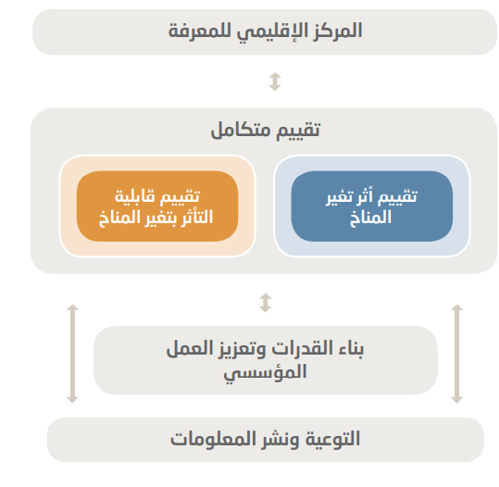
ﺭﻛﺎﺋﺯ ﺍﻟﻌﻣﻝ

Slide 9
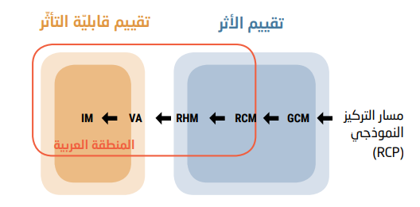
ﻣﻨﻬﺠﻴﺔ ﺍﻟﺘﻘﻴﻴﻢ ﺍﻟﻤﺘﻜﺎﻣﻞ
GCM: Global Climate Modelling VA: Vulnerability Assessment
RCM: Regional Climate Modelling IM: Integrated Mapping
RHM: Regional Hydrological Modelling

Slide 10
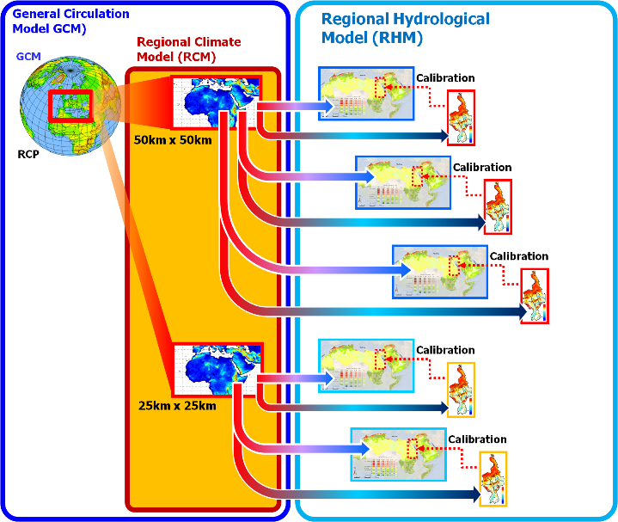
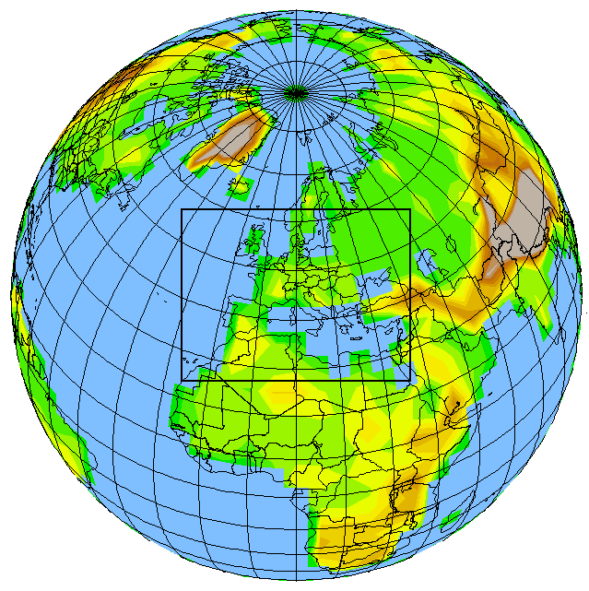
ﺍﻻﻧﺗﻘﺎﻝ ﻣﻥ ﺍﻟﻧﻣﺎﺫﺝ ﺍﻟﻣﻧﺎﺧﻳﺔ ﺍﻹﻗﻠﻳﻣﻳﺔ ﺇﻟﻰ ﺍﻟﻧﻣﺎﺫﺝ ﺍﻟﻬﻳﺩﺭﻭﻟﻭﺟﻳﺔ
Different GCMs
Extreme Climate Indices
GCMs at
300 km x 300 km
Ensemble Average used to reduce uncertainty at level of RCMs & RHMs
Ensembles compare findings of different RCMs & RHMs applied for same RCP & Domain
for the
Same RCP

Slide 11
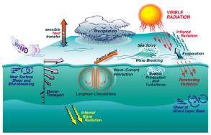
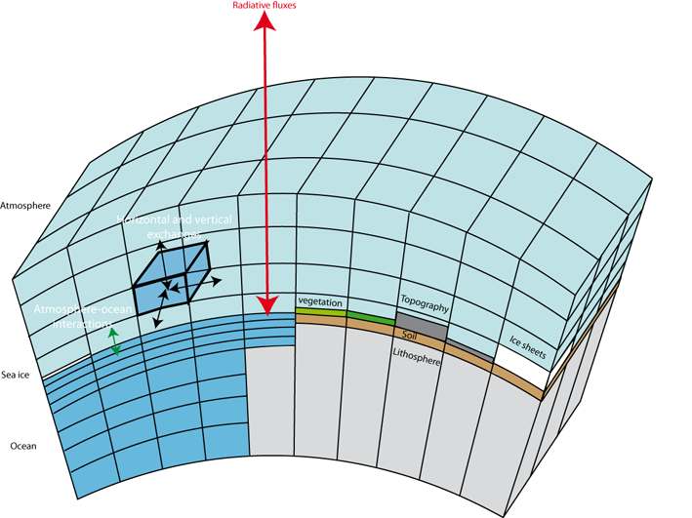
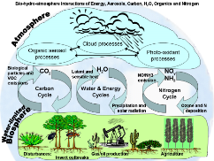
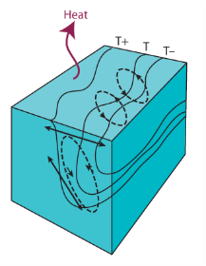
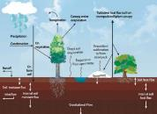
ﺣﻭﺳﺑﺔ ﻣﺗﻐﻳﺭﺍﺕ ﺍﻟﻣﻧﺎﺥ
Vertical level
REF: http://stratus.astr.ucl.ac.be/textbook/chapter3_node8.html
http://www.nesl.ucar.edu/LAR/2007/strategic-priorities/sp2/index.php
Atmosphere
Oceans
Terrestrial

Slide 12
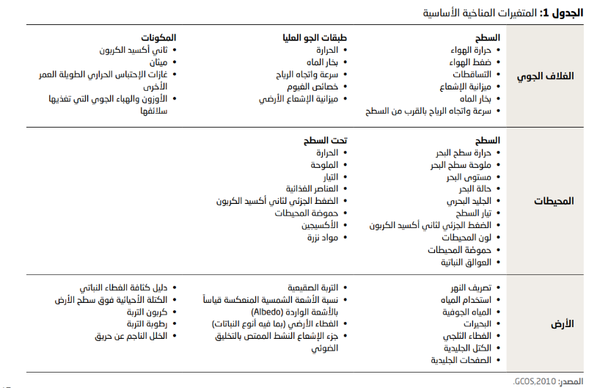
متغيرات المناخ الأساسية: يتم إنشاؤها لكل خلية شبكية
Essential Climate Variables (ECV) datasets provide the empirical evidence needed to understand and predict the evolution of climate
RICCAR RCMs are land-based models and do not generate Oceanic Variables
https://gcos.wmo.int/en/essential-climate-variables/table
Notes:
P, T are the most commonly used raw outputs generative from climate modelling experiments. Raw and bias corrected data for the RICCAR projections are openly available for analysis or use in your own modelling work.
How to access other available essential climate variables will be discussed during Module 5….such wind speed and direction, humidity …. which can be used for projecting sand and dust storms. Snow cover is also available.
RICCAR work is a land-based model that generates atmosphere and land-based essential climate variable.
We do not include ocean circulation models in our work, not analysis on sea level rise.

Slide 13
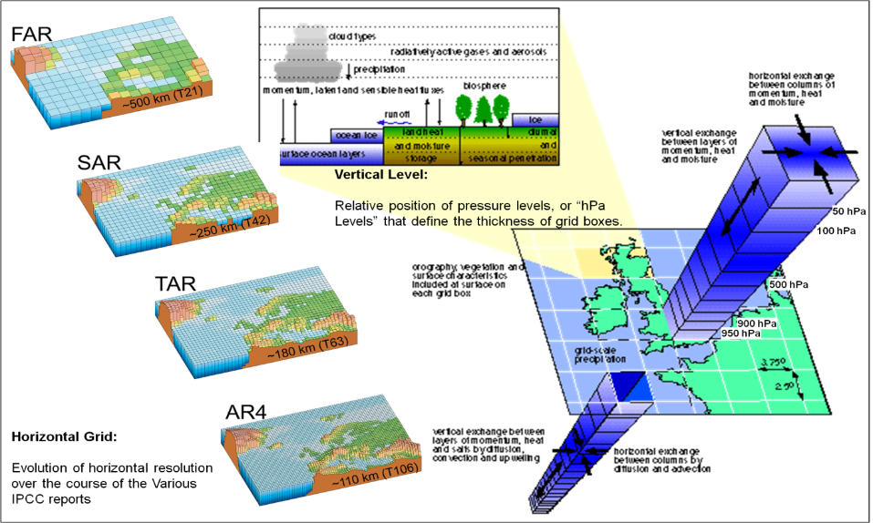
حوسبة متغرات المناخ :تحسين قياسات التحليل(الدقة)مع مرور الأوقات
1990
1995
2001
RICCAR Arab/MENA Domain Outputs at
50x50 km & 25x25 km
2007
AR5 in 2014
AR6 in 2021/2022
IPCC, 2007; Met Office, 2011

Slide 14
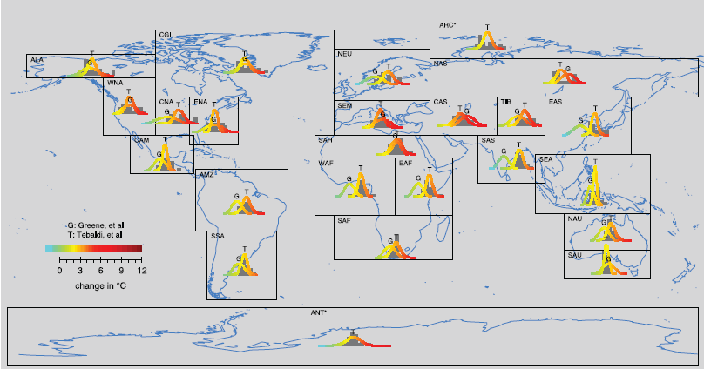
Then why a Regional Domain?
IPCC regional domains (2010)
From R.K Kolli, WMO
RICCAR EGM #2 (Beirut, 2010)

Slide 15
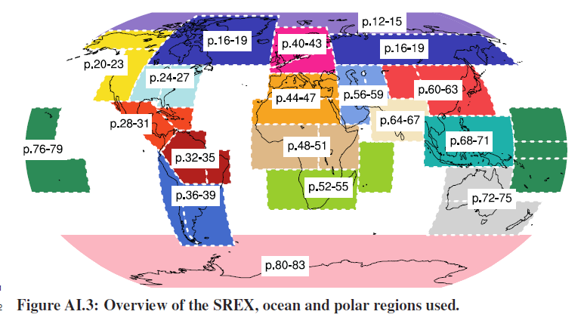
النطاقات المشمولة في تقرير الهيئة الحكومية الدولية المعنية بتغير المناخ 2013
SREX: Special Report on Managing the Risks of Extreme Events and Disasters to Advance
Climate Change Adaptation
IPCC Assessment Report 5 – WGI: Annex I
Draft: 30 September 2013

Slide 16
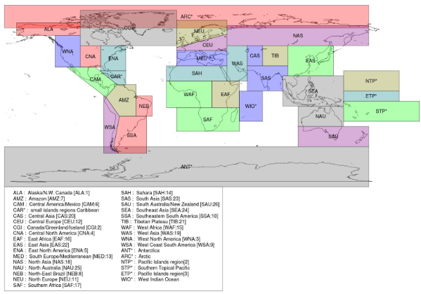
النطاقات المشمولة في تقرير الهيئة الحكومية الدولية المعنية بتغير المناخ 2014
Spatial boundaries of the
geographical reference regions used in the
IPCC 5th Assessment Report (AR5) (2014)
http://www.ipcc-data.org/guidelines/pages/ar5_regions.html

Slide 17
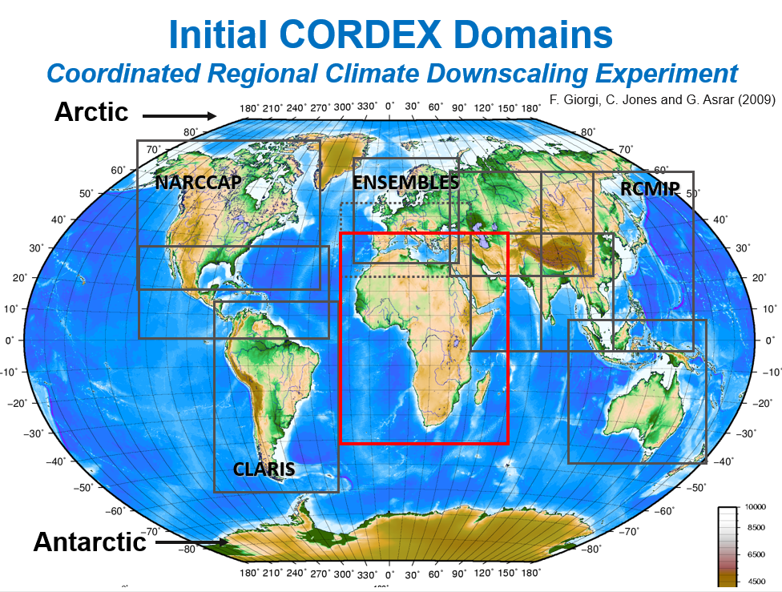
Notes:
Felippo GEE-or-GEE
Colin Jones (with SMHI) and
Ghassem R. Asrar
Promoting the set up of a Coordinated approach to Regional Climate Downscaling in 2009.
They initially identified the above domains to encourage climate research centres to coordinate and contribute output for the same area.
RICCAR was being launched around the same time in 2010.

Slide 18
CORDEX-MENA Working Group
Preliminary RCM Ensemble Meeting convened by SMHI (Brussels, 2013)
First CORDEX MENA-CA Meeting (Nicosia, Nov 2014)
Organized by CORDEX (WMO via World Climate Research Programme) with SMHI & hosted by The Cyprus Institute.
Consulted Institutions:
King Abdulaziz University (KAU) – (Saudi Arabia)
King Abdullah University of Science and Technology (KAUST) – (Saudi Arabia)
Istanbul Technical University (Turkey)
Bogazici University (Turkey)
Cairo University (Egypt)
Jet Propulsion Laboratory (USA)
Max Plank Institute for Chemistry (Germany)
Italian Aerospace Research Center (CIRA)
Qatar Meteorology Department (Qatar)
SMHI
ACSAD
Maroc Meteo
Cyprus Institute
ESCWA
WMO
UNESCO/Cairo Office

Slide 19
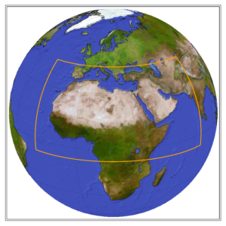
CORDEX-MENA/Arab Domain
CORDEX Domain
Region 13
Middle East/
North Africa

Slide 20
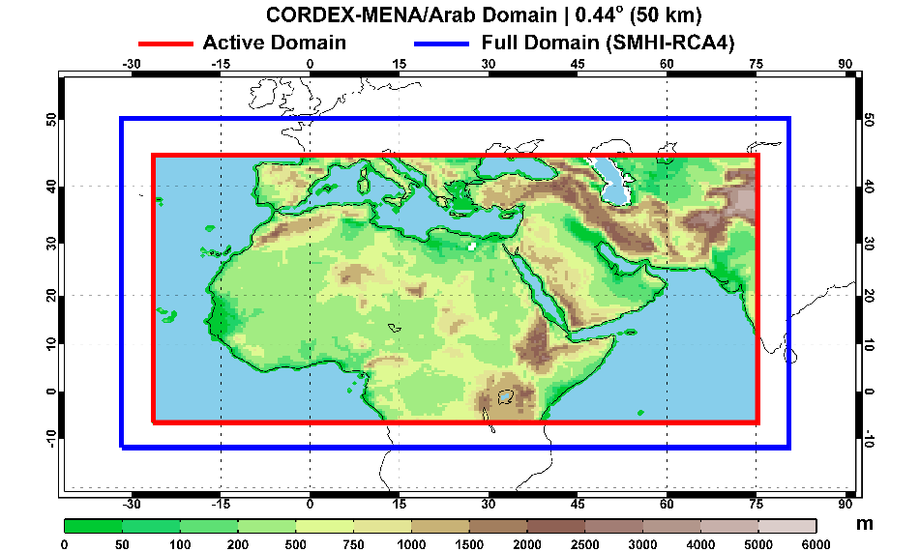
MENA/Arab Domain

Slide 21
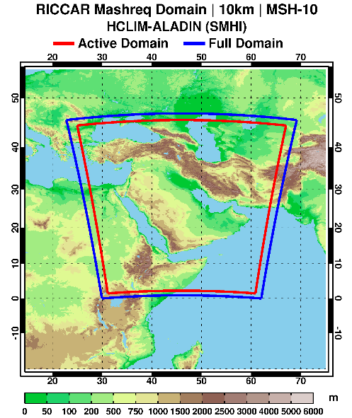





Mashreq Domain
Available beginning 2021
10 km² grid
RCP 8.5
ALADIN RCM nested in 6 GCMs
ALADIN: Aire Limitée Adaptation dynamique Développement InterNational

Slide 22
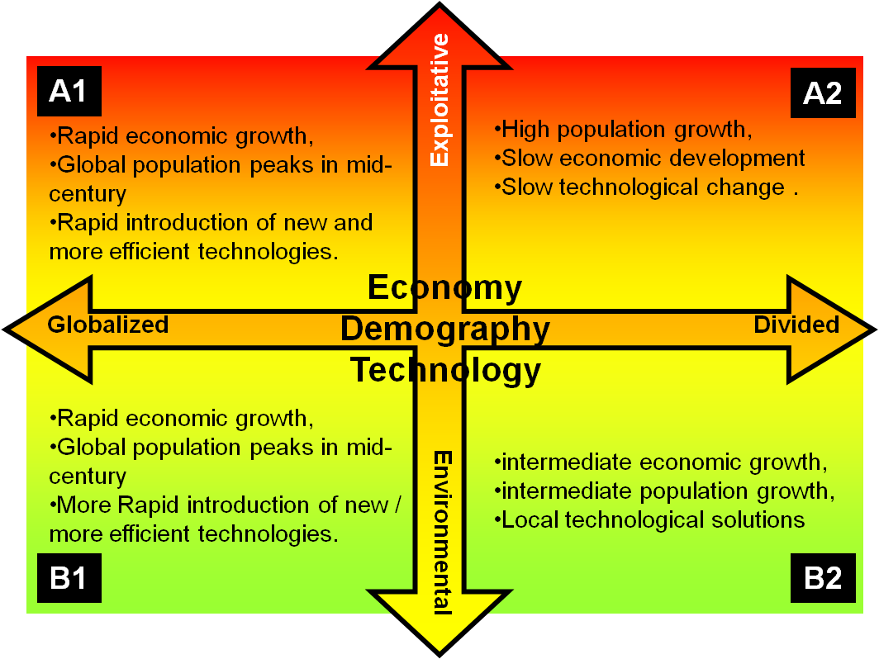
Climate Scenarios
Special Report on Emission Scenarios (SRES) used in IPCC AR4 (2007)
Average 3.4C Temp increase Scenario
Average 1.8 C Temp increase Scenario
Source: ESCWA, 2009

Slide 23
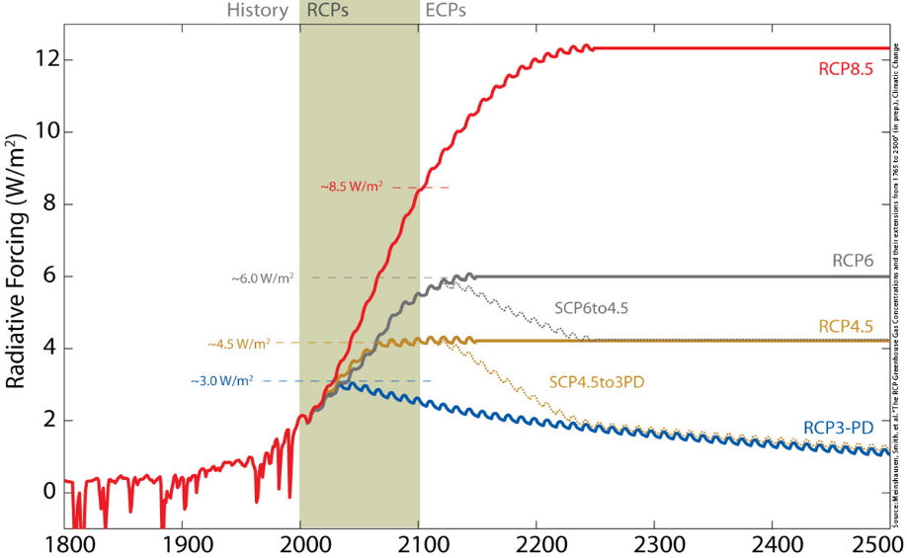
Representative Concentration Pathways (RCPs)
Scenarios used in IPCC AR5 (2014)
Neither will get us to less than 1.5C by 2100
CORDEX
High Emissions Scenario
CORDEX
Graph adapted from: Meinshausen et al.,2010

Slide 24
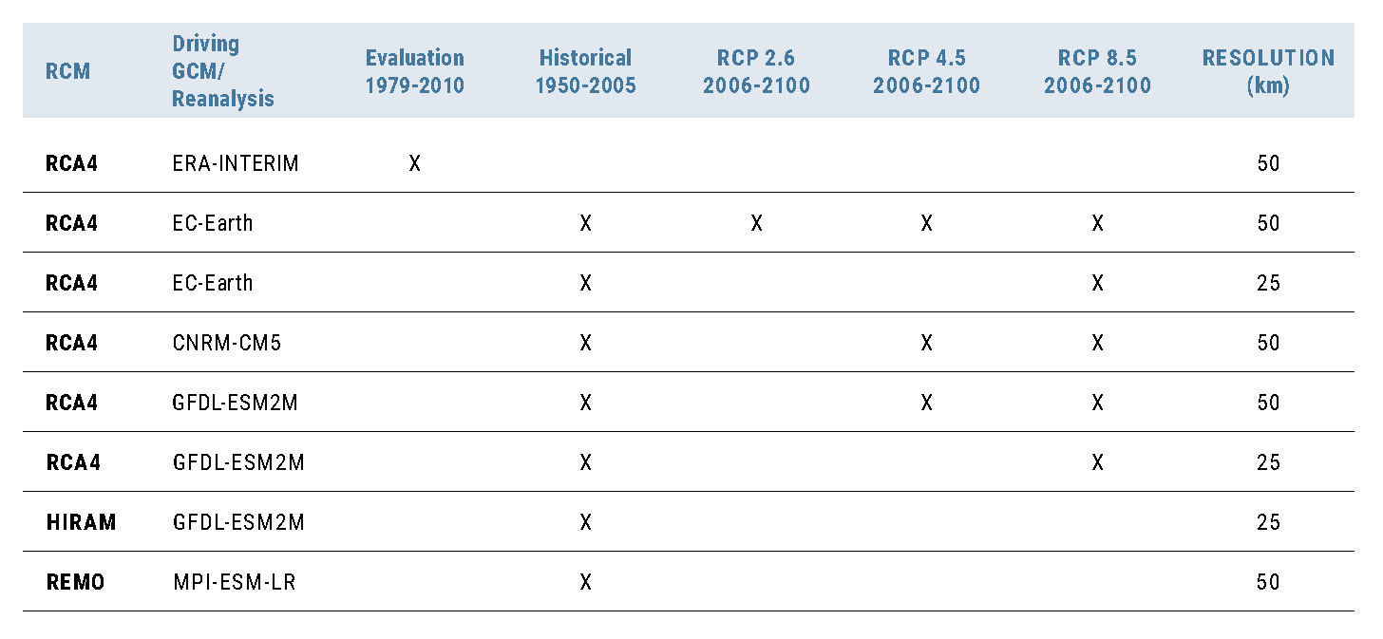
MENA/Arab Domain
RCM Simulations for RICCAR Ensembles
1986-2005
RCA4: SMHI Rossby Centre regional atmospheric model HiRAM: High Resolution Atmospheric Model; REMO: RCM Climate Service Center (Germany)
RICCAR Main Report (2017) findings for MENA/Arab Domain presented Ensembles for
RCP 4.5 & RCP 8.5 for the Historical Period; Mid-Century; End-Century,
but data can be customized for daily/monthly/yearly time periods for smaller areas

Slide 25

Accessibility to MENA-CORDEX Simulations
Acronym | Contributor | City, Country | Terms of use
BOUN | Bogazici University | Istanbul, Turkey | Unrestricted Available on ESGS
CLMcom | CLM Community – Centro EuroMediterraneo sui Cambiamenti Climatici (CMCC) | Caputa, Italy | Restricted
GERICS | Climate Service Center | Hamburg, Germany | Restricted
CyI | The Cyprus Institute* *Hosts MENA-CORDEX | Nicosia, Cyprus | Restricted Non-commercial use only
DMN | Direction de la Météorologie Nationale | Casablanca, Morocco | Restricted
ICBA | International Centre for Biosaline Agriculture | Dubai, United Arab Republic | Restricted
SMHI | Swedish Meteorological and Hydrological Institute – Rossby Centre | Norrköping, Sweden | Unrestricted Available on ESGS Bias-corrected data available on RICCAR RKH in NetCDF & GIS
ESGS: Earth System Grid Federation is an international collaboration consisting of federated data centres with data nodes with harmonized metadata & in NetCDF.
Notes:
Module 2 next week will discuss NetCDF datasets, which are compact files used store climate datasets.
ESGF nodes provide projections in NetCDF formats
Module 3 will then get into how to extract NetCDF datasets for use in ArcGIS, which can in turn be used for other types of geospatial climate change analysis.
BO-GAAAA-Zi Zi University has a couple projections on the ESGS as well.

Slide 26
Time scale:
Change in Mean Temperature Ensemble Output

Slide 27
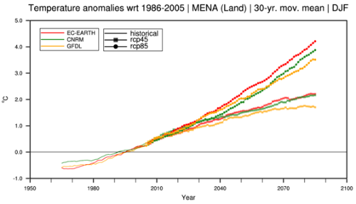
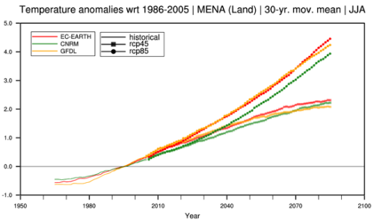
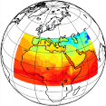
Temperature Ensembles through a
Seasonal Lens
Winter
}
RCP 8.5 Ensemble
}
RCP 4.5 Ensemble
Depends on
which future you imagine & decide to plan against
(which climate scenario)
Summer
}
RCP 8.5 Ensemble
}
RCP 4.5 Ensemble
Notes:
27

Slide 28
Precipitation trends are largely decreasing across the region until the end of the century, though limited areas expected to exhibit an increase in the intensity & volume of precipitation
From RICCAR RCM ensemble outputs

Slide 29
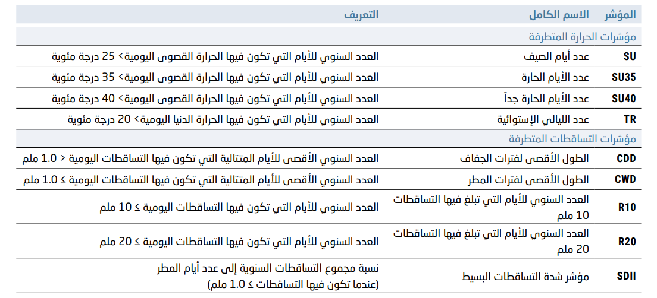
مؤشرات الظواهر المناخية المتطرفة

Slide 30
Maximum length of dry spell (CDD)
From RICCAR RCM ensemble outputs

Slide 31
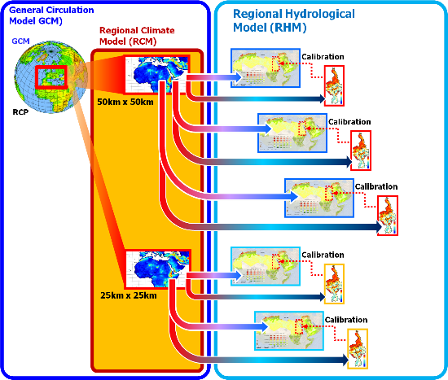
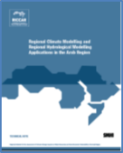
Regional Climate Modelling to
Hydrological Modelling
Different GCMs
Bias Correction of RCM Projections needed before data can be used for water & agricultural modelling
VIC
HYPE
HEC-HMS
Models Used
300 km x 300 km
Ensembles used to reduce uncertainty at level of RCMs & RHMs
Ensembles aggregate findings of different RCMs & RHMs applied for same RCP & Domain
Same RCP
Notes:
HYPE: Hydrological Predications for the Environment model
Semi-distributed catchment model that describes hydrological processes in different sub-basins for the purpose of providing multi-basin analysis.
Is SMHI’s main model with open source codes
VIC: Variable Infiltration Capacity model
Semi-distributed macro-scale hydrological model that looks at water and energy balances
Has been applied to most major river basins
It is also an open source model developed by the University of Washington in the USA
HEC-HMS: used for flood analysis for 3 basins in the Extreme Events led by ACSAD

Slide 32
Mean change in annual runoff
2 Hydro Models; 2 RCPs
Comparison between 2 hydrological models based on SMHI modelling outputs:
Hydrological Predictions for the Environment (HYPE) and Variable Infiltration Capacity (VIC)
Notes:
Annual runoff presented in mm per month, and daily data available upon request.
Ensemble for Hype and Vic available on the RKH for 20 year period using mm/month averaged over 20 year period.

Slide 33
Mean change in annual runoff

Slide 34
Mean change in annual evapotranspiration
2 Hydro Models; 2 RCPs
Notes:
RICCAR bias corrected input inform ET projections and comes from the Hydrological modelling, and not as RCM outputs – although land-based models generate ET as an Essential Climate Variable.
By using Hydro modelling – and event 2 modelling – we have greater confidence in the projections which are important not only for water available but also as inputs to agricultural productivity models, such as AquaCROP.

Slide 35
Mean change in annual evapotranspiration

Slide 36
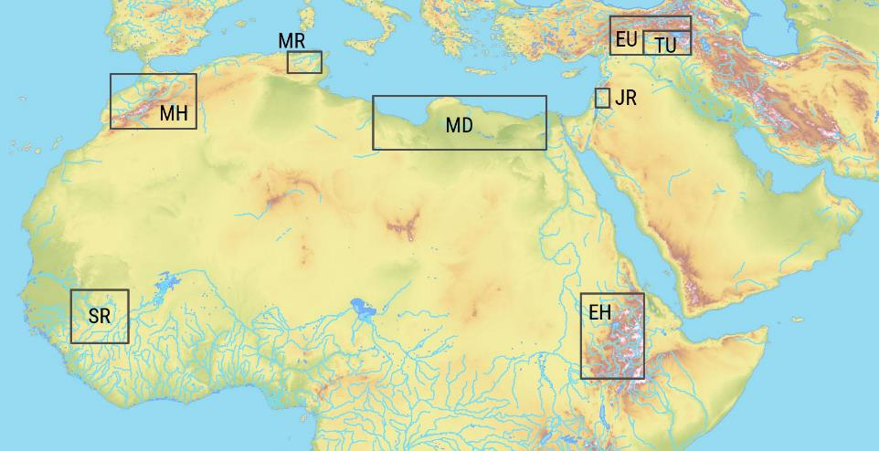
Locations of subdomains for hydrological analysis

Slide 37
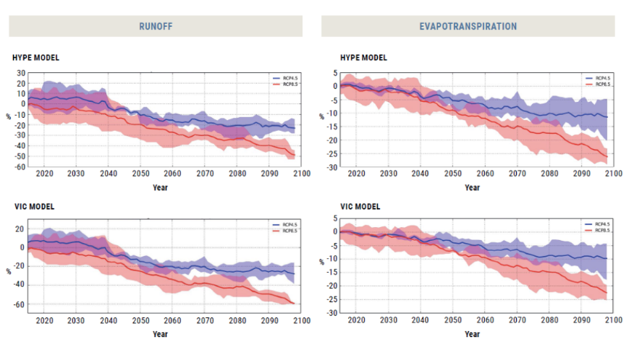

Mean change in runoff & evapotranspiration
Moroccan Highlands (MH)

Slide 38

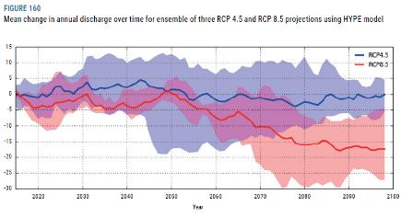
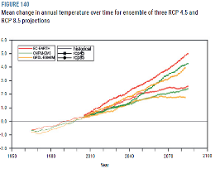
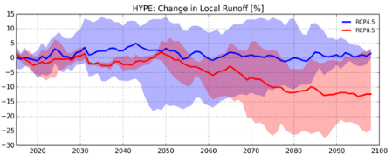
Climate Impacts on Transboundary Water Resources: Euphrates River
Upper Euphrates River
(1986-2005) : (2081-2100)
Variable | RCP4.5 | RCP8.5
Temp. | 2.3◦C | 4.8◦C
Precip. | 3% | 0%
Runoff | -2% | -12%

Slide 39
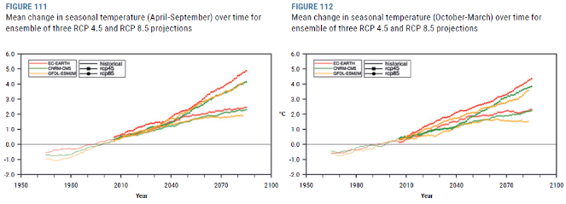
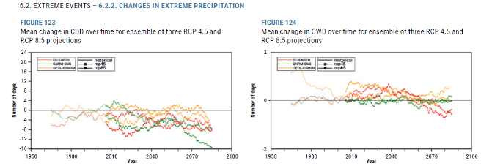
الآثار المناخية على الموارد المائية العابرة للحدود : حوض نهر دجلة الأعلى
Upper Tigris River:
Seasonal Temperature
(RCM output)
Upper Tigris River:
Extreme Climate Indicators:
Consecutive Dry Days
Consecutive Wet Days
(RCM output)

Slide 40
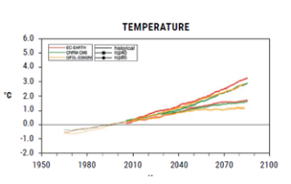
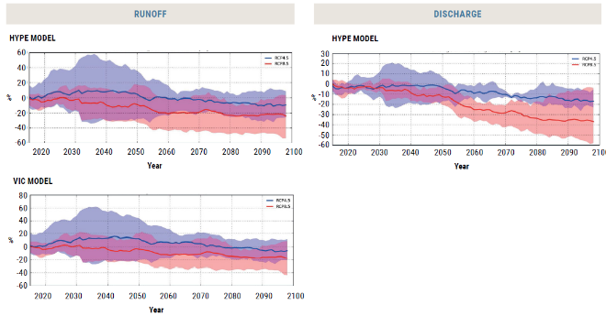
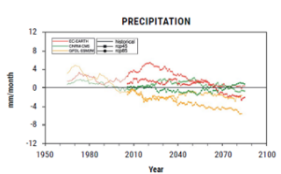
الآثار المناخية على الموارد المائية العابرة للحدود: حوض نهر الأردن
Jordan River Basin Projections for T, P, Runoff, Discharge for a
three-member ensemble of RCP 4.5 projections and
three-member ensemble of RCP 8.5 projections using
Hype Model and VIC Model (which cannot be combined into a larger ensemble)

Slide 41
STRECHING BREAK!

Slide 42
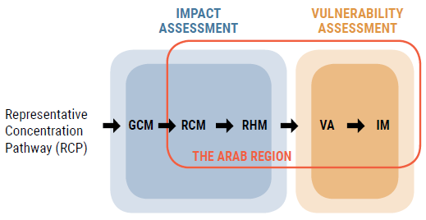
ﻣﻨﻬﺠﻴﺔ ﺍﻟﺘﻘﻴﻴﻢ ﺍﻟﻤﺘﻜﺎﻣﻞ
GCM: Global Climate Modelling VA: Vulnerability Assessment
RCM: Regional Climate Modelling IM: Integrated Mapping
RHM: Regional Hydrological Modelling

Slide 43
Integrated Vulnerability Assessment

Slide 44
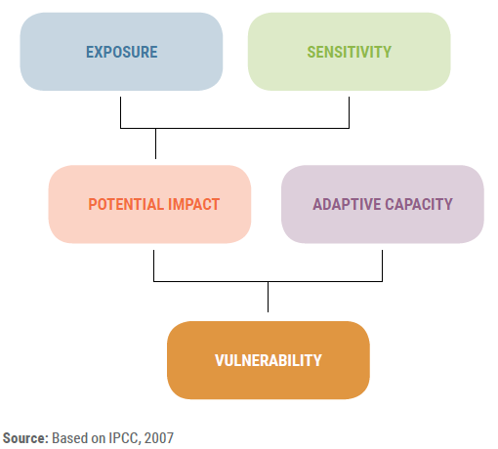
ﺗﻘﻳﻳﻡ ﻗﺎﺑﻠﻳﺔ ﺍﻟﺗﺄﺛﺭ

Slide 45
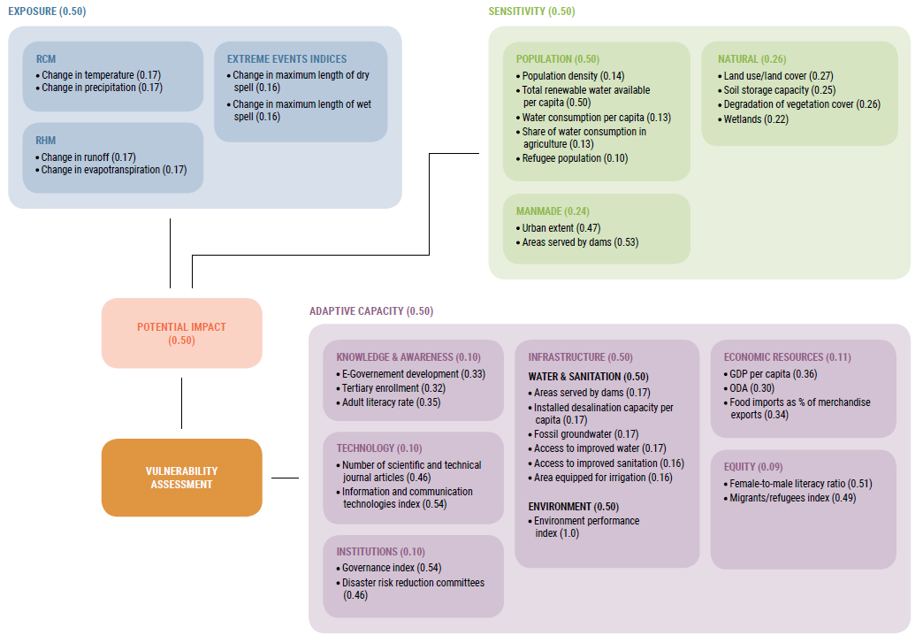

Impact chain of water availability sector
6
Exposure indicators
10 Sensitivity indicators
20 Adaptive Capacity indicators

Slide 46
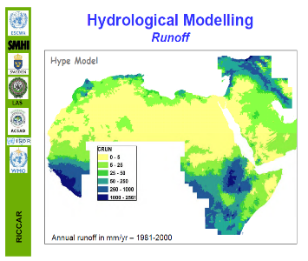
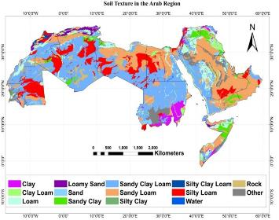
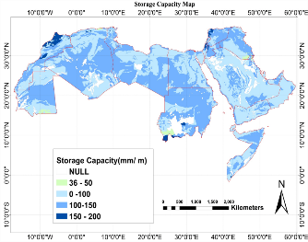
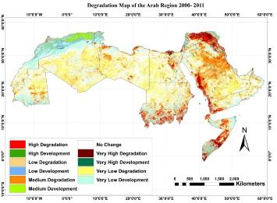
Overall Vulnerability
Preparation of a Vulnerability Index:
Per Sector
  Contains all indicators identified to assess a given sectors
  Attribution of weights for each indicator dependent on impact chains and expert judgment
    As sector level, aggregated by component: Exposure, Sensitivity, Adaptive Capacity
Overall Vulnerability
  Aggregates vulnerability of each sector to generate an Overall VA
  Supports identification of VA Hotspots
+
+
+
+…
Slide graphics: adelphi
Source of maps: ACSAD, SMHI

Slide 47
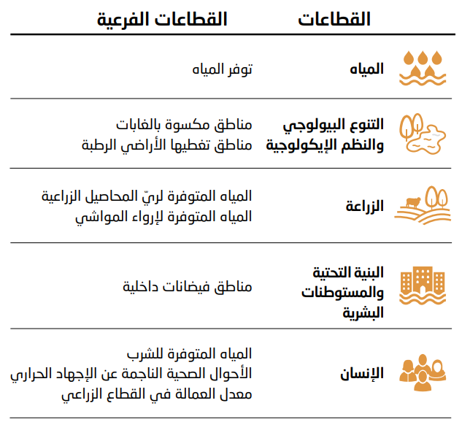
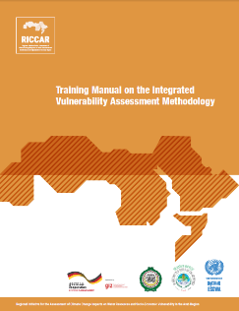
القطاعات المستهدفة

Slide 48
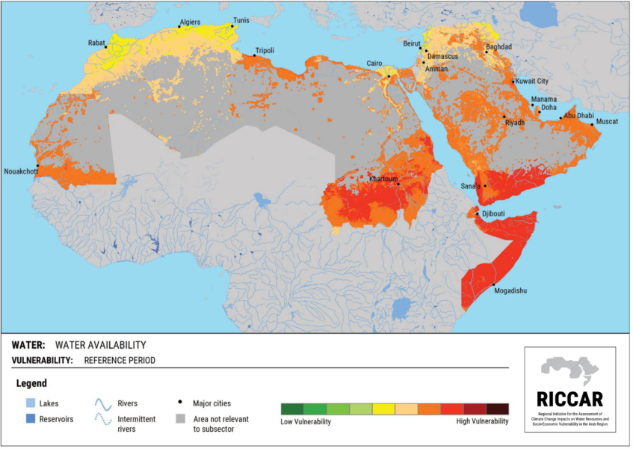
Water Availability
Reference Period
(1986-2005)

Slide 49
Water Availability
Mid-Century RCP 4.5

Slide 50
Water Availability
End-Century RCP 4.5

Slide 51
Water Availability
End-Century RCP 8.5

Slide 52
Vulnerability Assessment

Slide 53
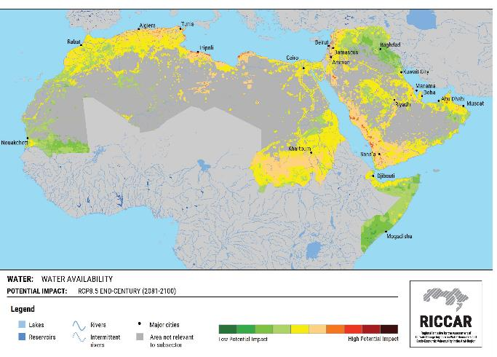
Water Availability: Potential Impact
End-Century RCP 8.5
Areas with highest potential impact:
Asir Mountains,
Green Mountains
Eastern Jafara Plain Basin.
Areas with lowest potential impact
Southern Horn of Africa
Central Tigris-Euphrates Basin

Slide 54
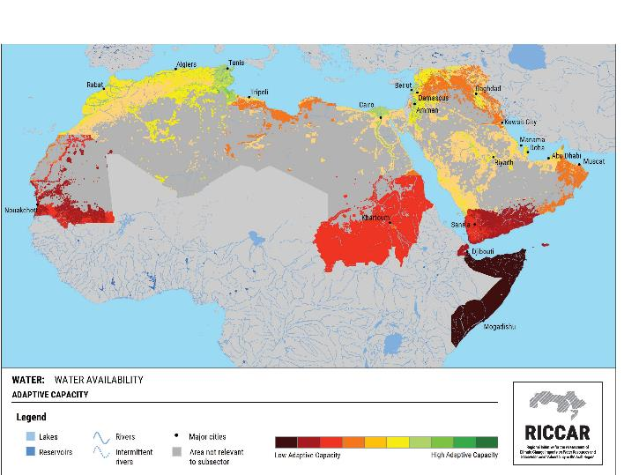
Water Availability: Adaptive Capacity
Demonstrates the socio-economic dimensions affecting the ability to respond to climate change impacts
Least Developing Countries have least Adaptive Capacity
(supports SDG13 call for targeted support for LDCs)
* Scale is based on comparison across
21 Arab States

Slide 55
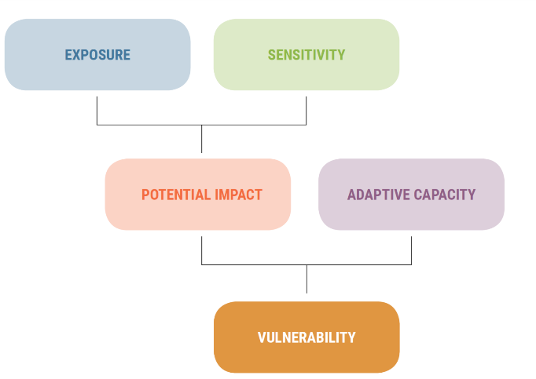

File formats for each indicator
Netcdf (daily data, ensembles)
Raster actual/ classified
Map actual/classified
Factsheet
Excel file
Raster actual/ classified
Map actual/classified
Factsheet
Excel file
6 different file formats for each indicator
Raster actual/ classified
Map actual/classified
Factsheet
Excel file
Notes:
RKH – has all the GIS files, and all bias-corrected RCM outputs
ESGS has the raw output from the RCM modelling expiriments

Slide 56




Lebanese Agricultural Sector Vulnerability Assessment

Slide 57
Regional Knowledge Hub
www.riccar.org

Slide 58

Regional Knowledge Hub
www.riccar.org

Slide 59

Publication Series

Slide 60




Regional Knowledge Nodes
Adaptation Node:
Resources and analysis that draw upon RICCAR findings to inform other climate change work related to Arab States.
Includes Case Studies and Training Materials

Slide 61

Data Portal
https://rkh.apps.fao.org/

Slide 62












RKH linked to ACCCP
ESCWA coordinates RICCAR within the framework of its
Arab Centre for Climate Change Policies (ACCCP)
Support also provided to Arab Climate Outlook Forum

Slide 63
Framing YOUR Assessment
When drawing upon a Regional Climate Modelling, Hydrological Modelling or Vulnerability Assessments, consider:
Do you need projected Outputs or Inputs for use in other models?
What Scale of Analysis is relevant for your needs?
Which Essential Climate Variables can inform your analysis?
Which Extreme Climate Indices could strengthen your analysis?
What Domain to use or draw upon for regional climate modelling?
Which climate Scenario is relevant to your purpose?
When to use an Ensemble of projections for quantifying the range of uncertainty?
What Time Period(s) do you aim to cover in your analysis?
We look forward to helping you to pursue your own climate change analysis!

Slide 64
Thank You
هيام الأشقر
خبيرة نظم معلومات جغرافية وتحليل بيانات نماذج مناخية
إدارة الموارد المائية
المركز العربي لدراسات المناطق الجافة والأراضي القاحلة (أكساد)
hiamalashkar2014@gmail.com
www.acsad.org

